Slide 1
Year 12 Physics Trip
17th to 21st July

Slide 2
Staffing
Mr Wilson
Miss Bramley
Miss Clarey
Mr Walker
Mr Rhodes

Slide 4
Itinerary
06:15 on Thursday 17th July: Depart St Aidan’s Car Park for Manchester Airport
11:05 Flight Departs
13:55 Flight arrives into Geneva
15:00 Coach to Lausanne
16:00 Tour of the Plasma Research Centre
19:30 Meal at the hostel

Slide 5
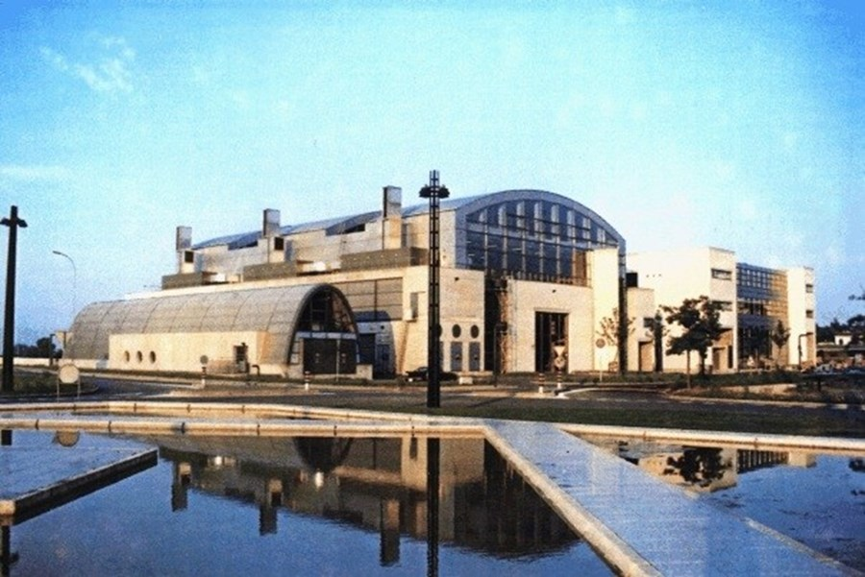

Slide 6
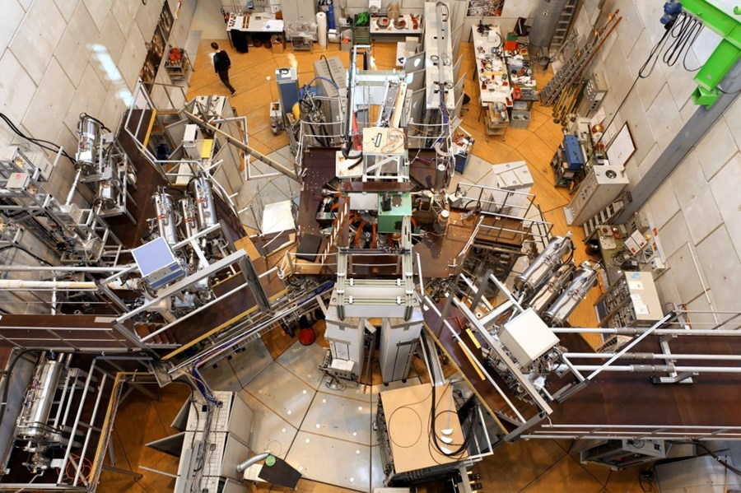

Slide 7
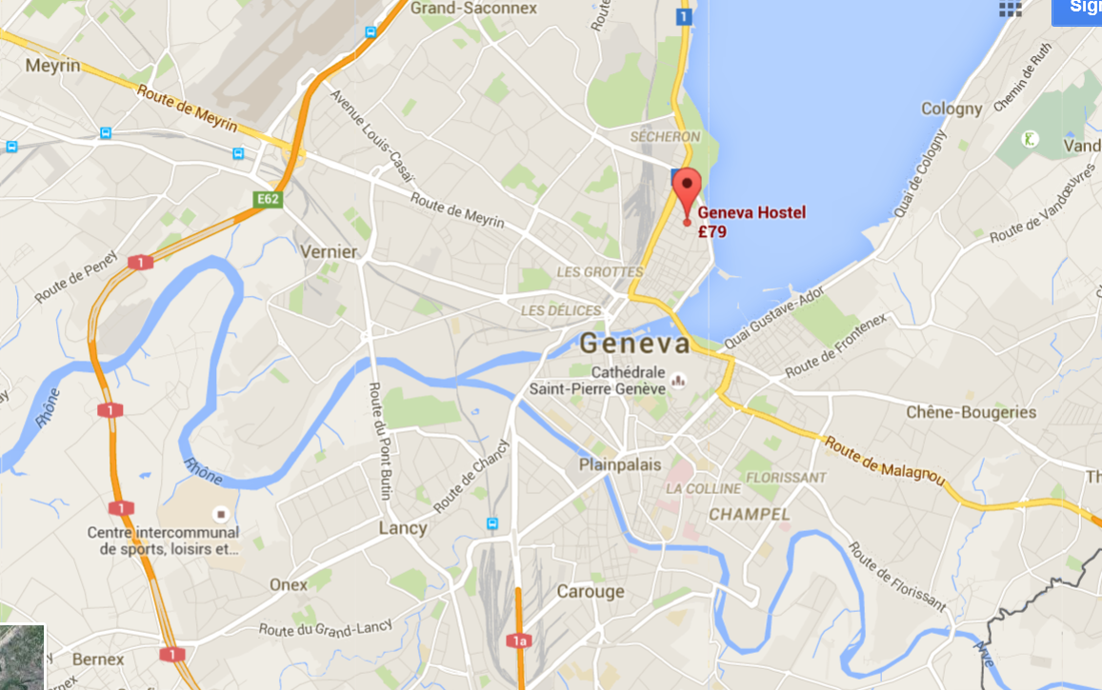

Slide 8
Friday 18thJuly
7:00 Breakfast
9:00 Guided tour of CERN
11:00 Universe of Particles- CERN
12:45 Lunch at CERN
14:00 CERN Science Gateway
17:00 Laser Tag
19:45 Meal at Restaurant Les Armures

Slide 9
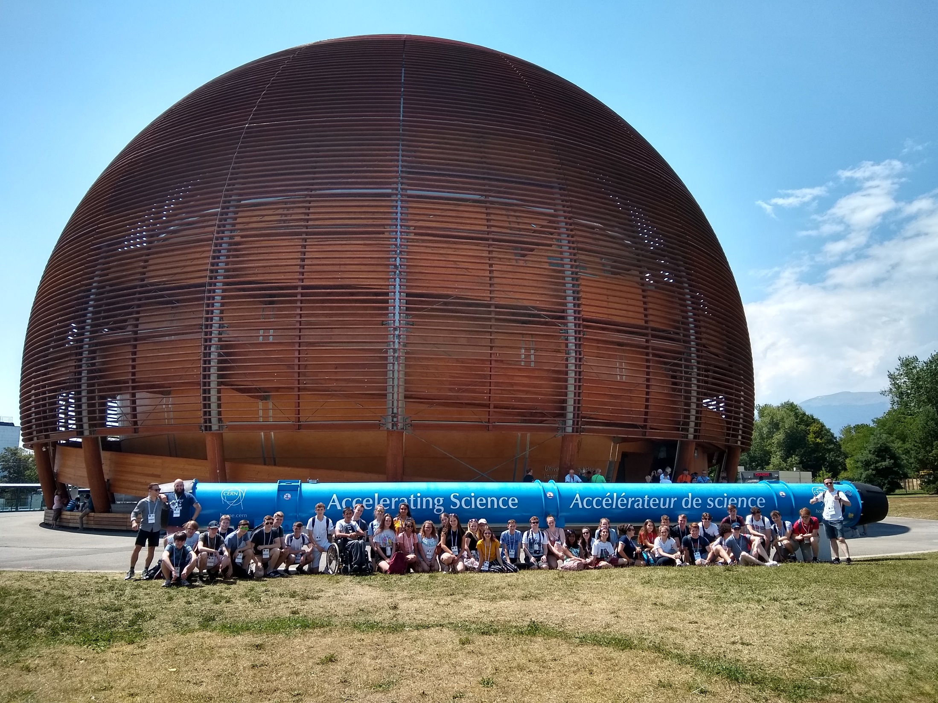

Slide 10
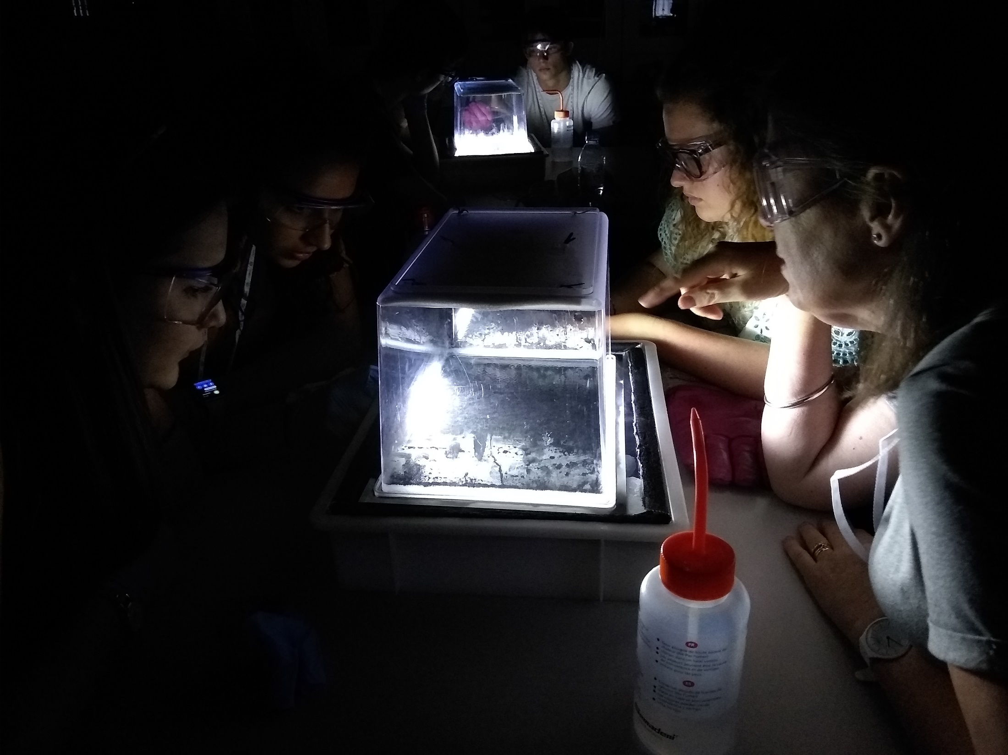

Slide 11
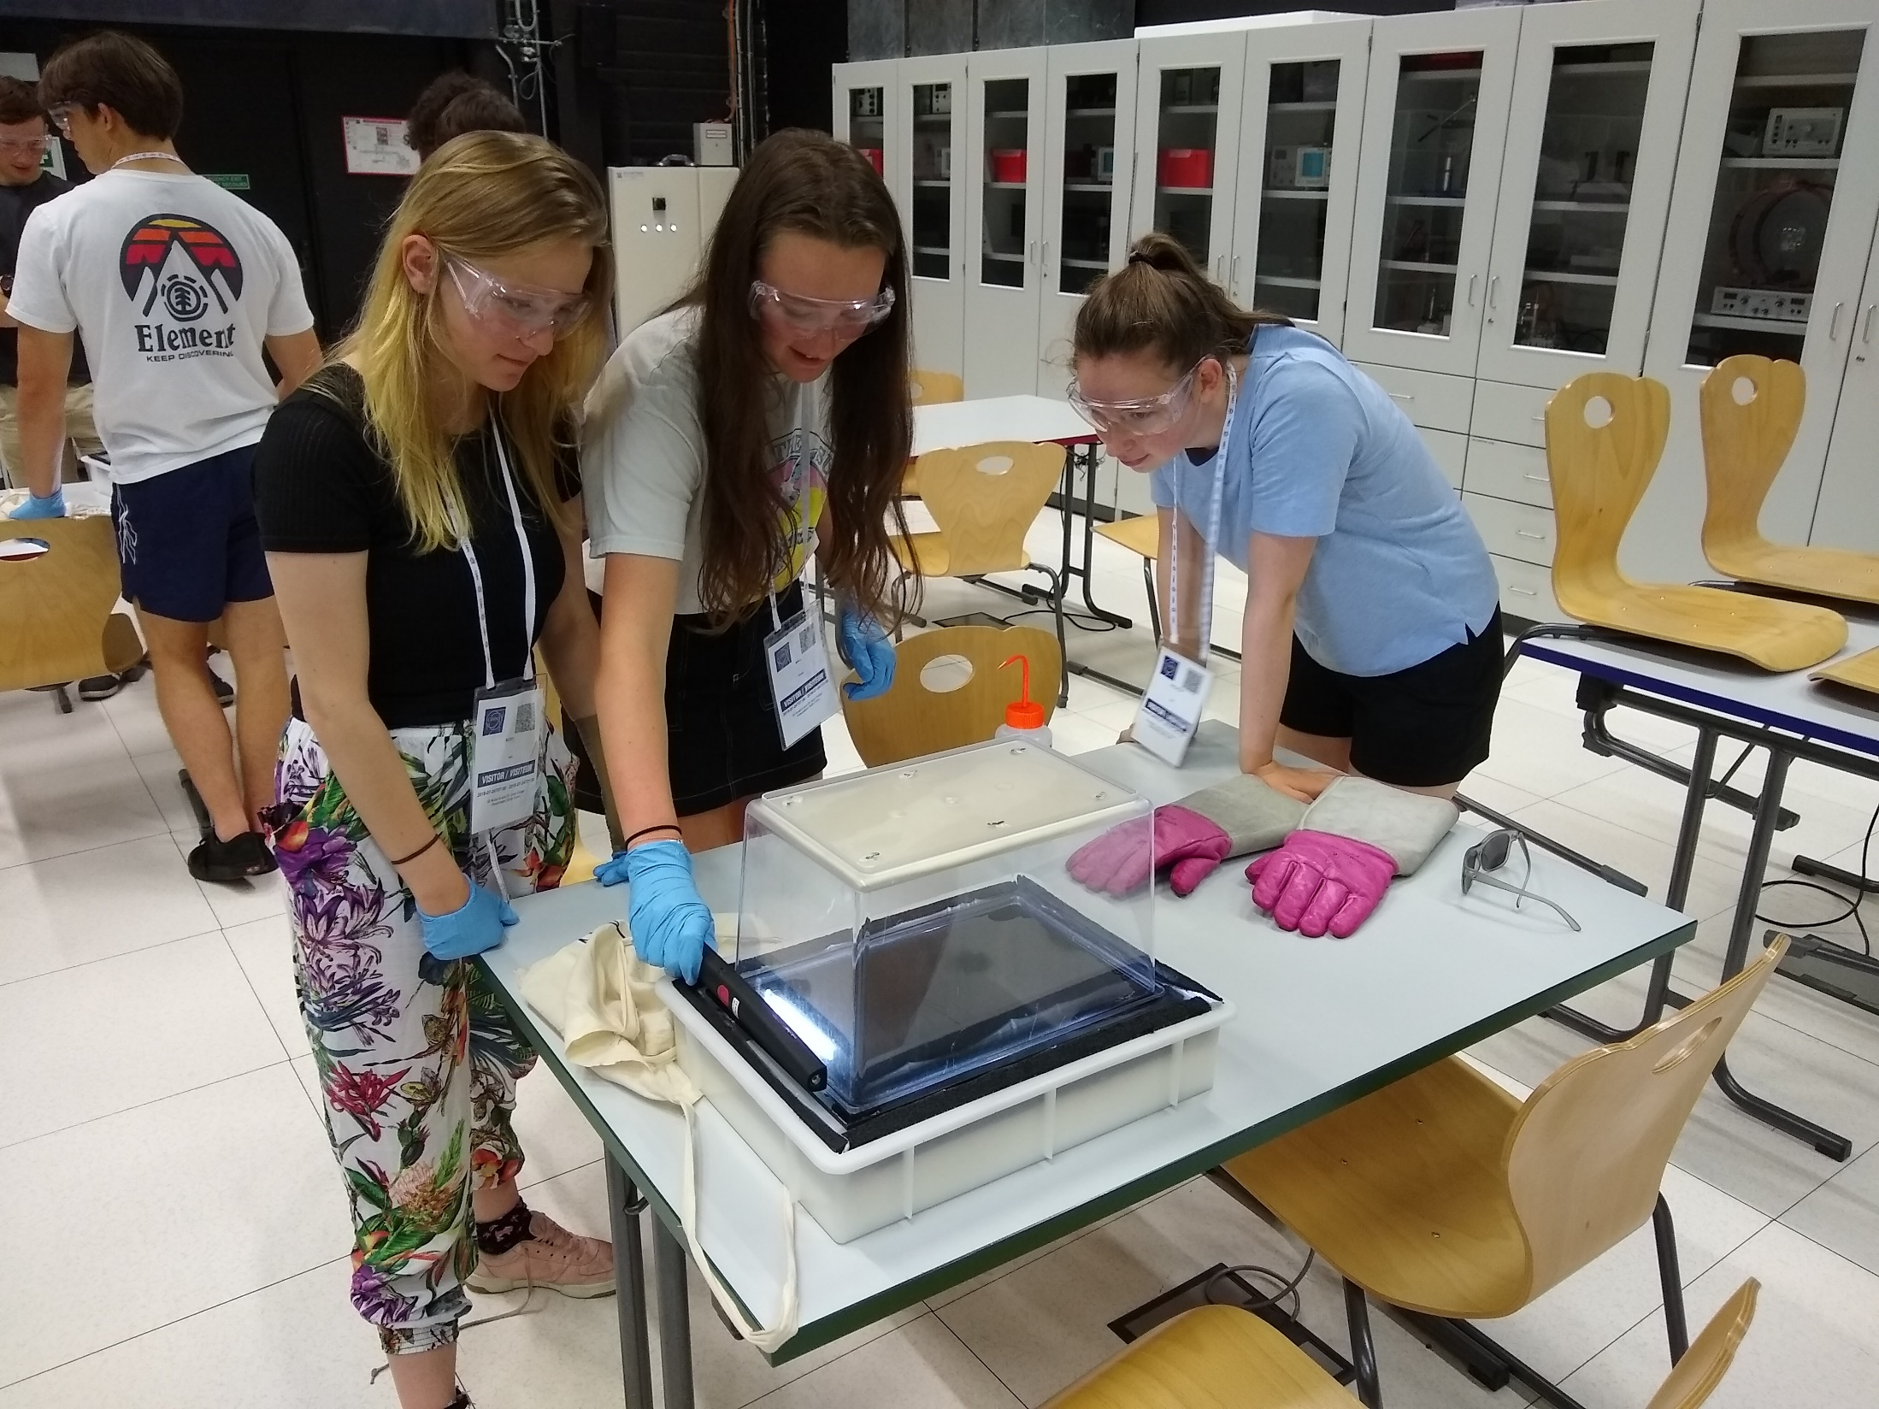

Slide 13
Saturday 19th July
7:00 Breakfast
08:30 Excursion to Electrobroc
14:00 Geneva’s Lake Walk to Old Town
16:20 Cruise of Lake Geneva
19:00 Dinner at Restaurant Molino Molard

Slide 14
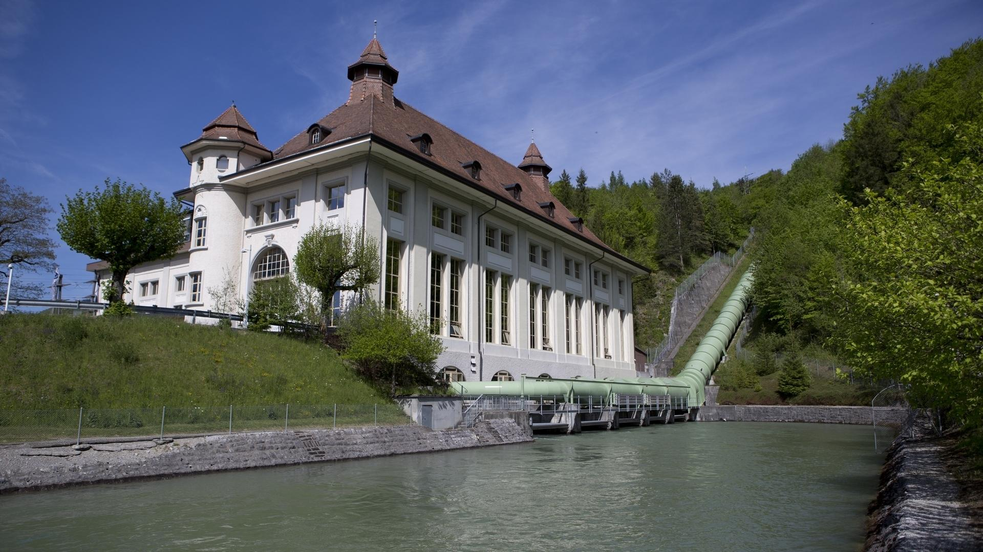

Slide 15
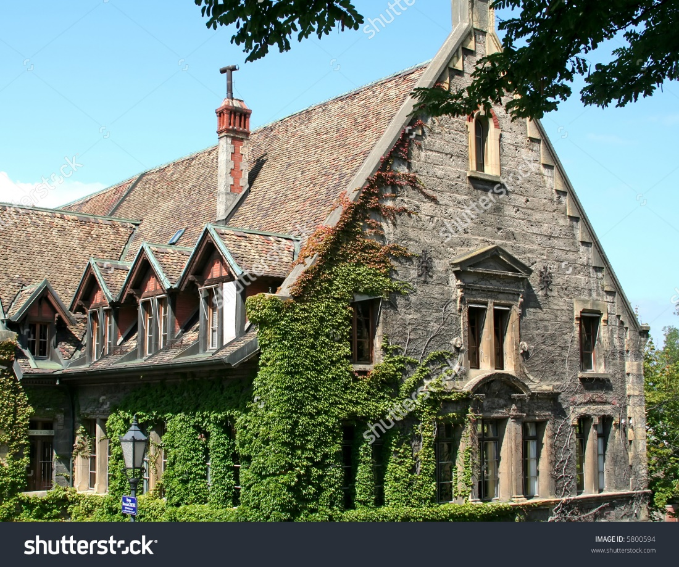
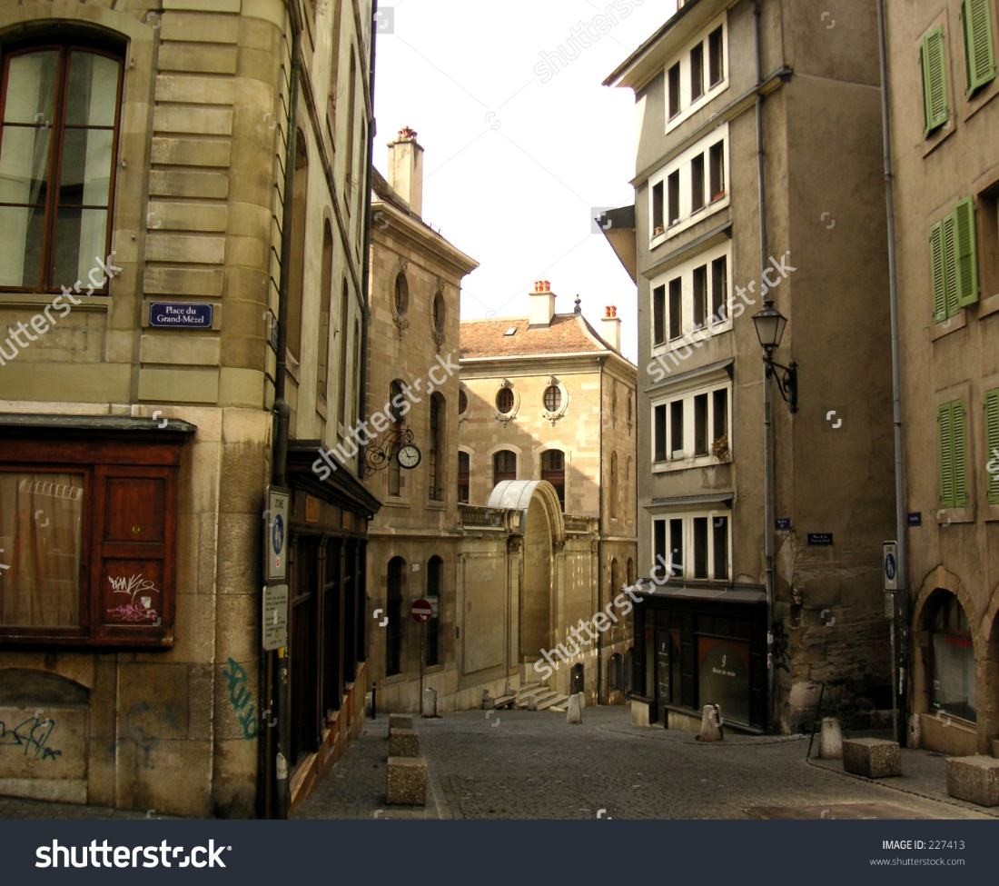
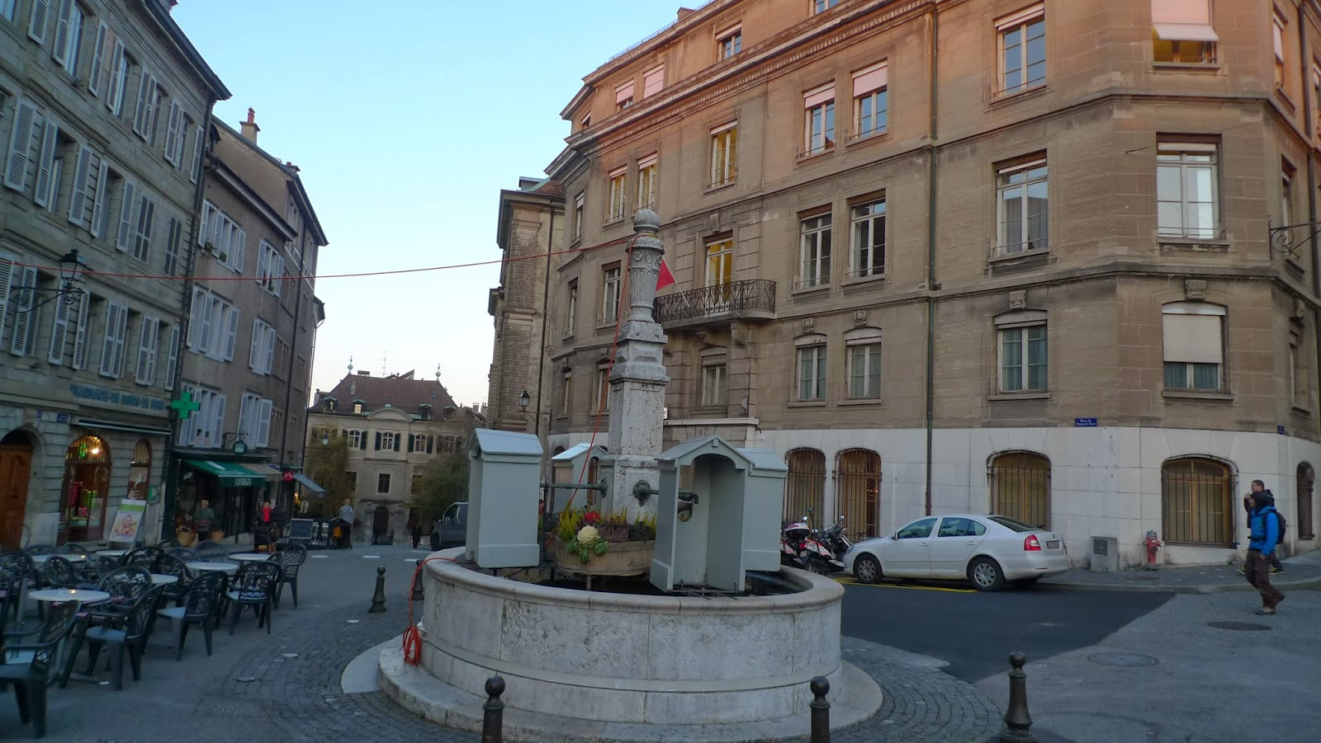
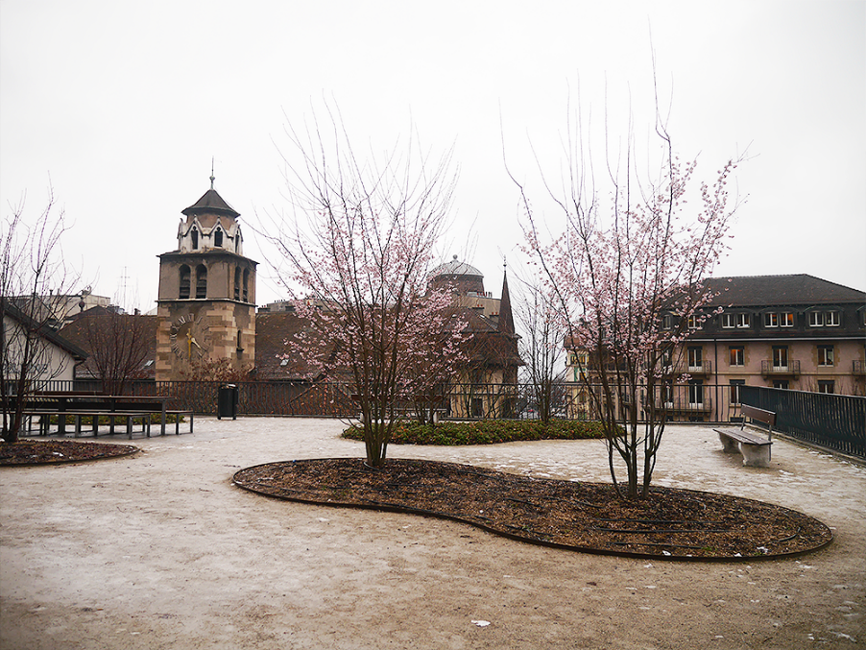

Slide 16
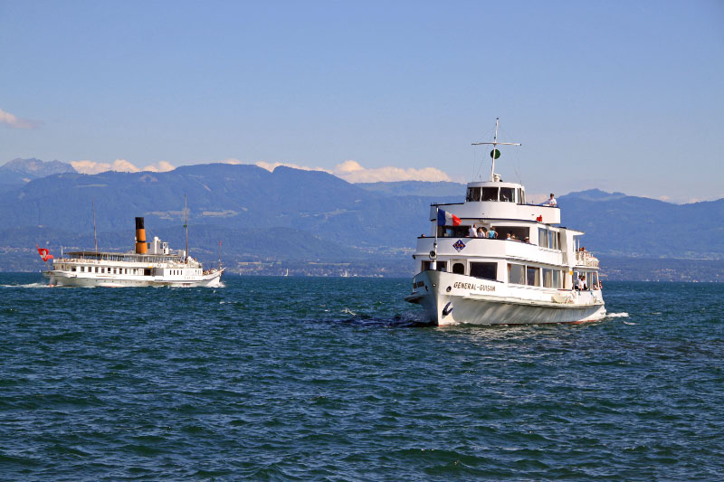
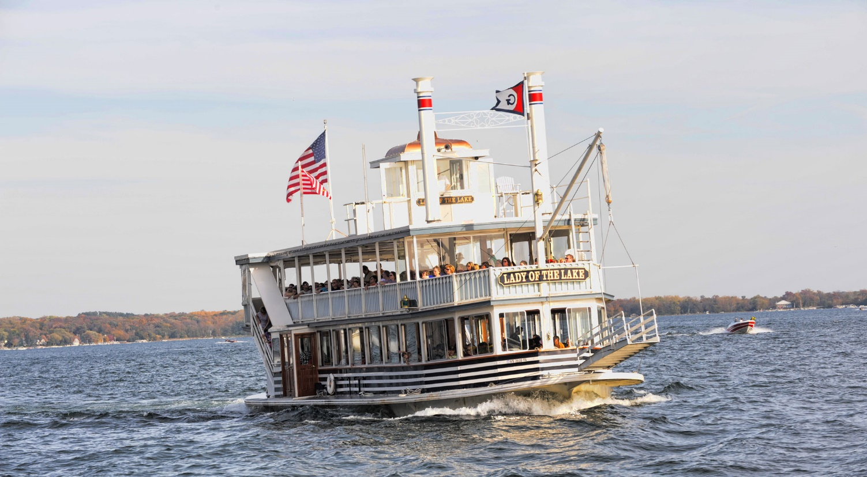
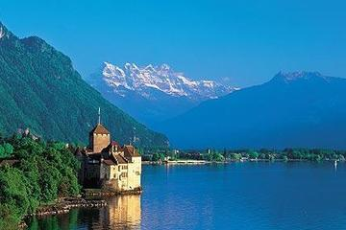

Slide 17
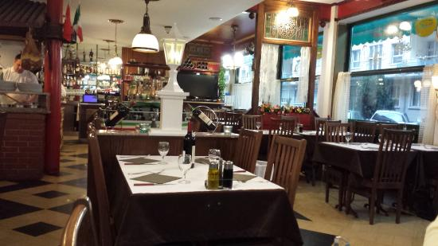

Slide 18
Sunday 20th July
7:30 Breakfast
10:00 Cable Car and tour of Mont Saleve
15:00 Red Cross and Red Crescent Museum
17:30 Geneva’s waterfront
18:30 Dinner at Il Fornello Napoletano

Slide 19
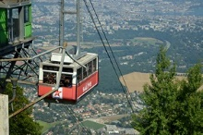
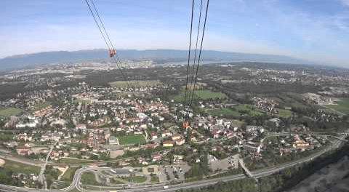
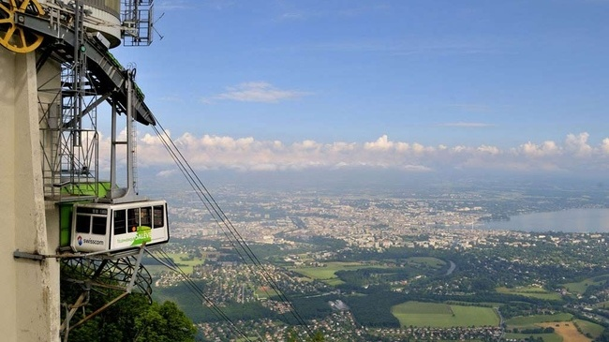

Slide 20
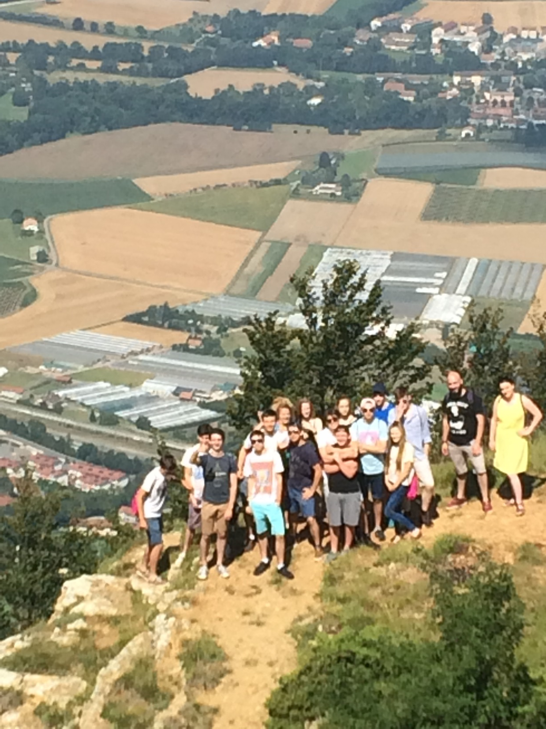

Slide 21
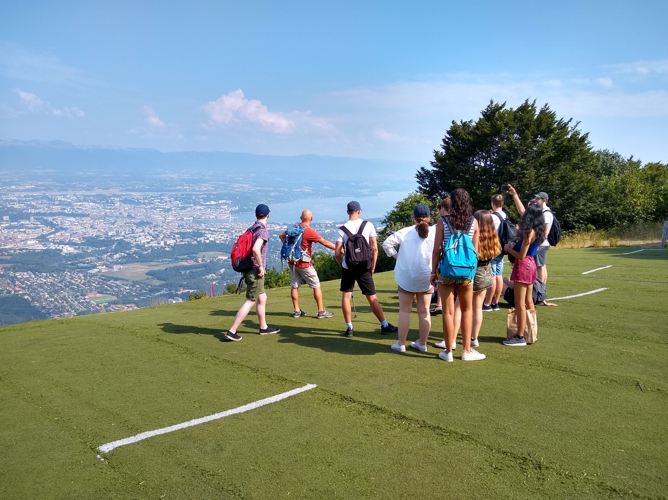

Slide 22
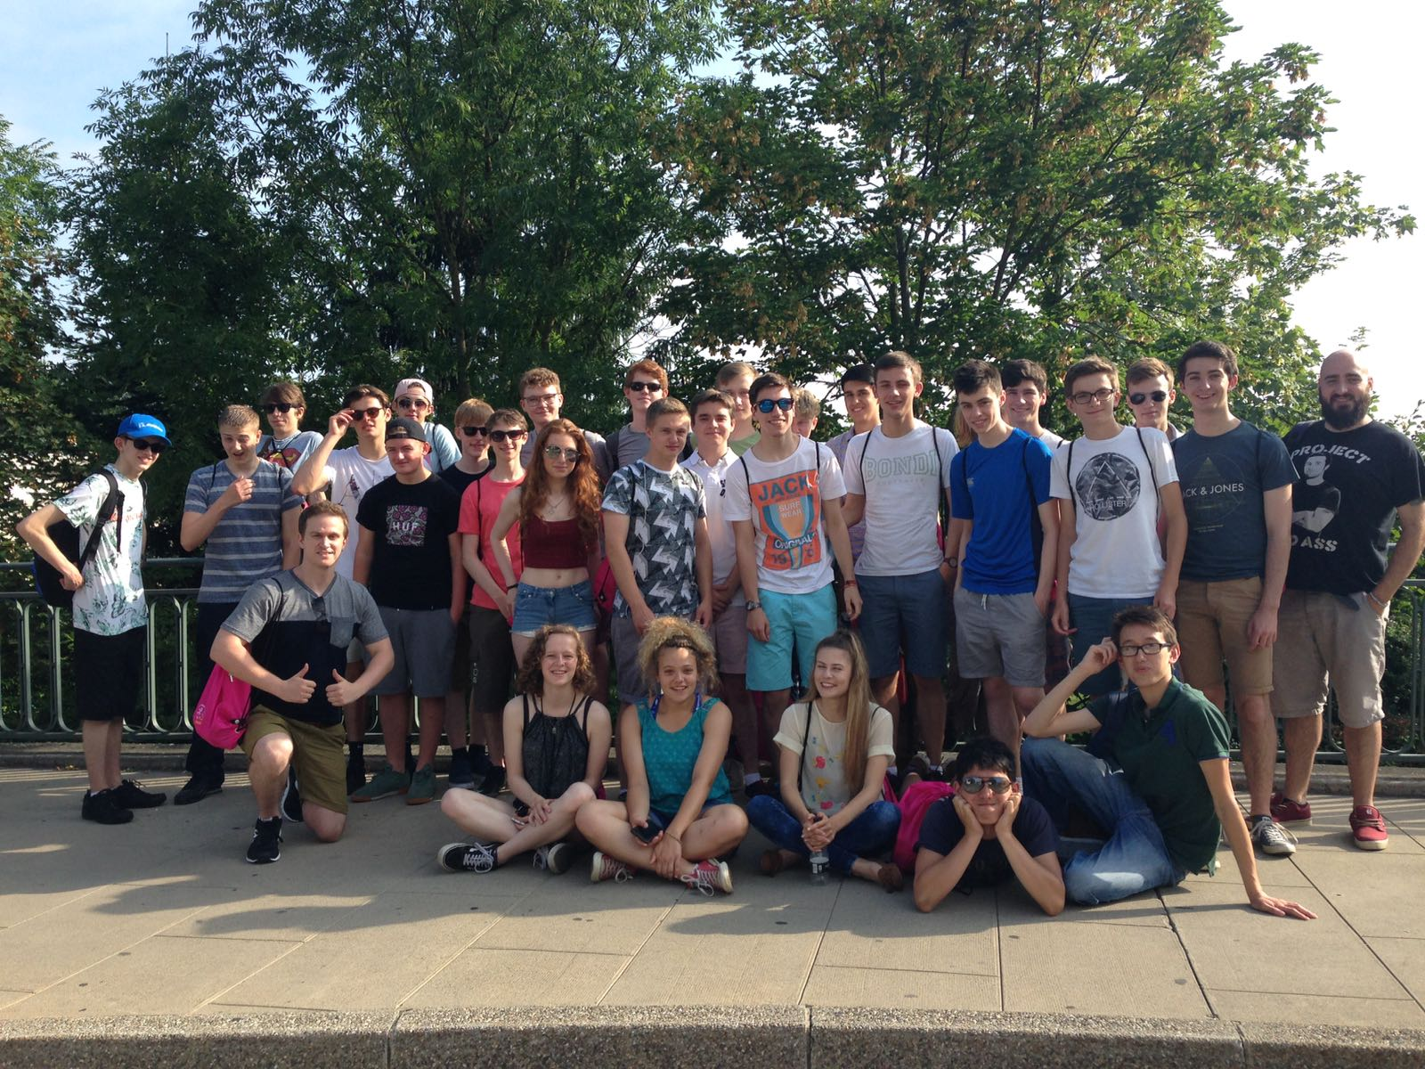

Slide 23
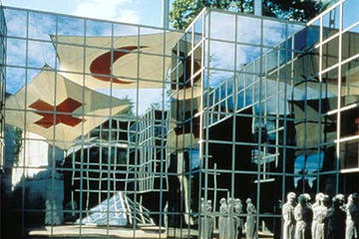
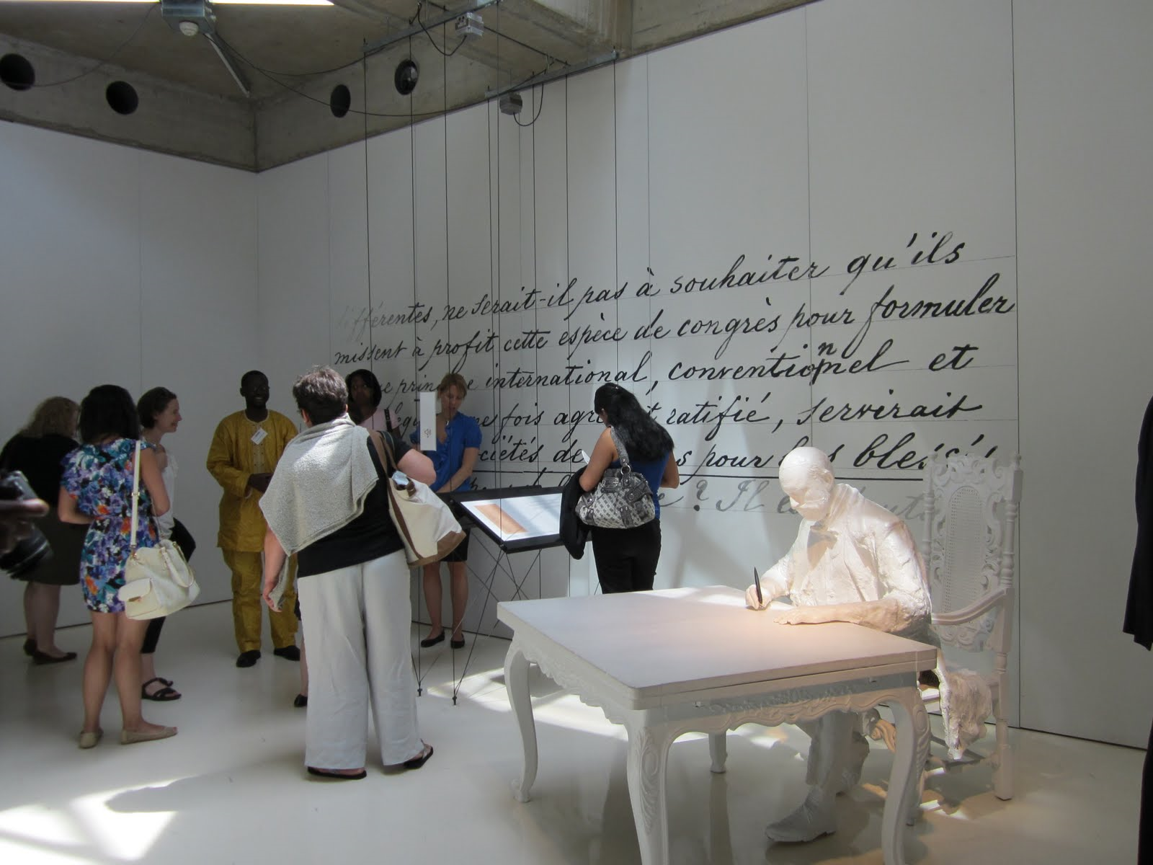
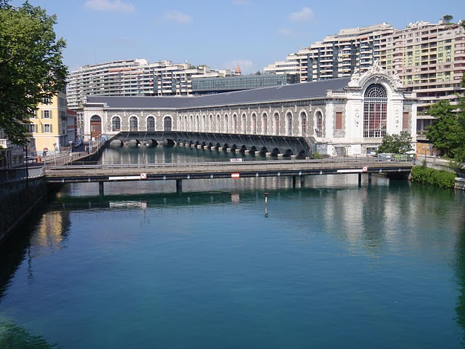

Slide 24
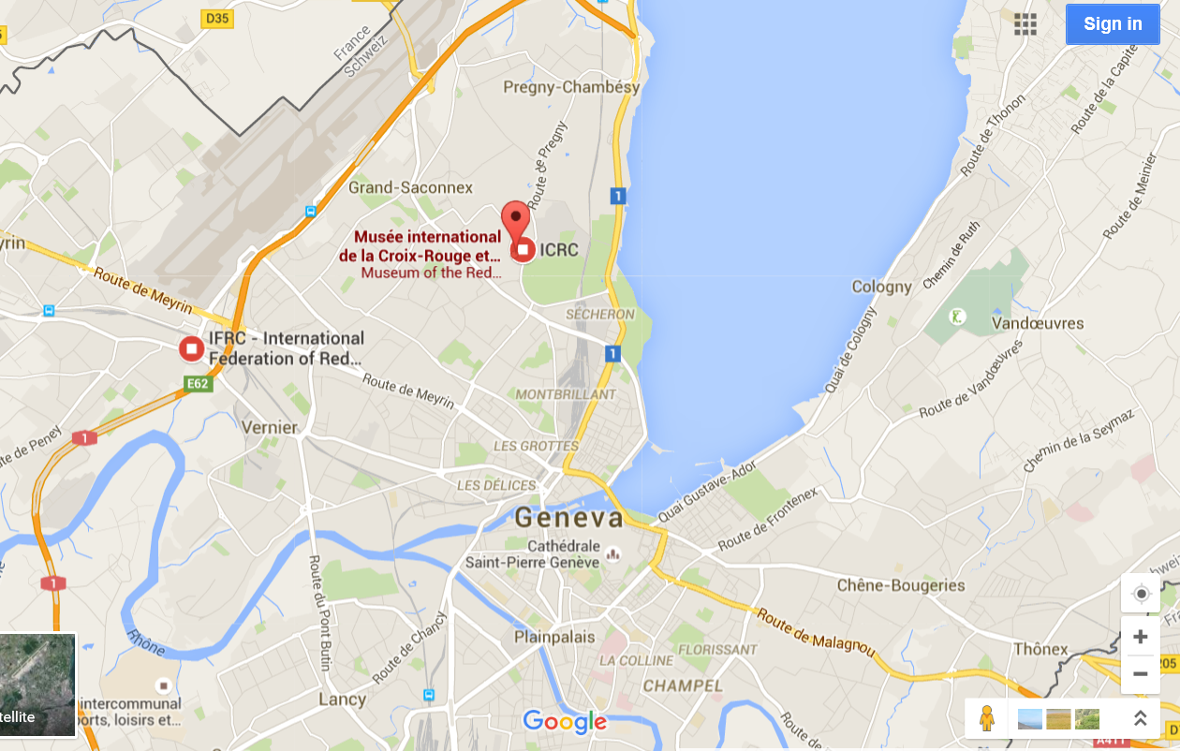

Slide 25
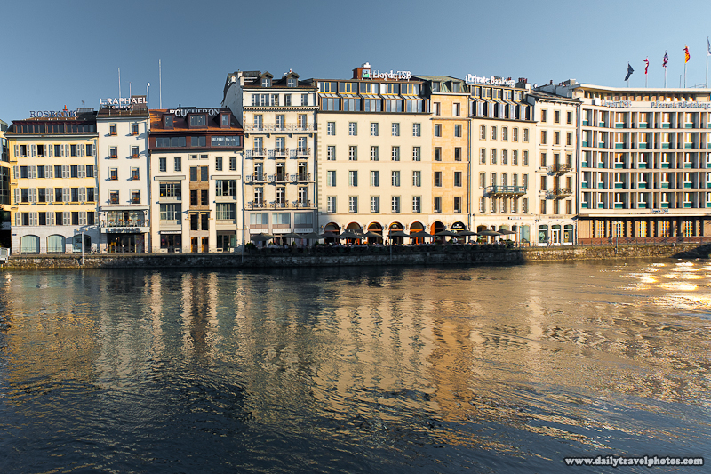
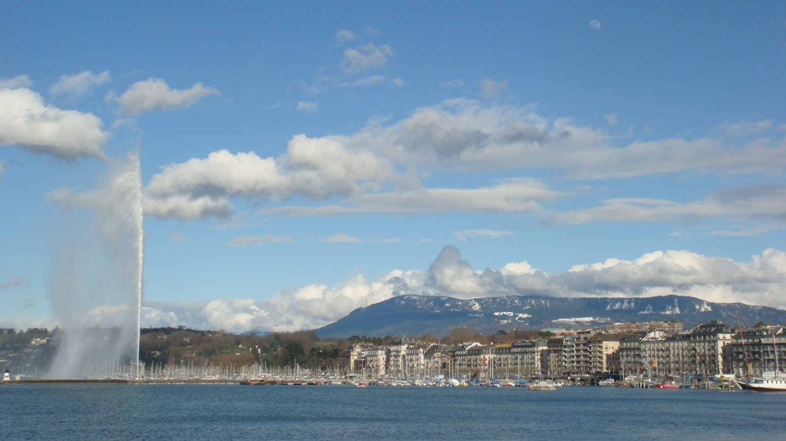
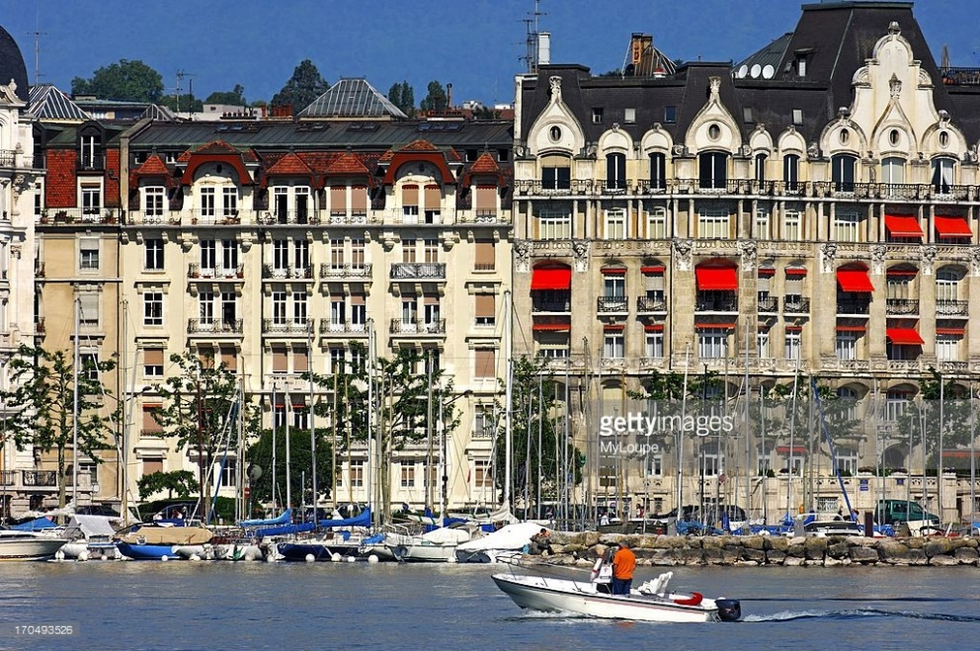

Slide 26
Monday 22nd July
7:00 Breakfast
8:30 History of Science Museum
10:30/12:00 Group tours of UN Palace of Nations
15:00 Check in at airport
17:00 Flight Departs to Manchester
17:55 Flight Arrives
20:00 Arrive back at St Aidan’s (approx.)

Slide 27
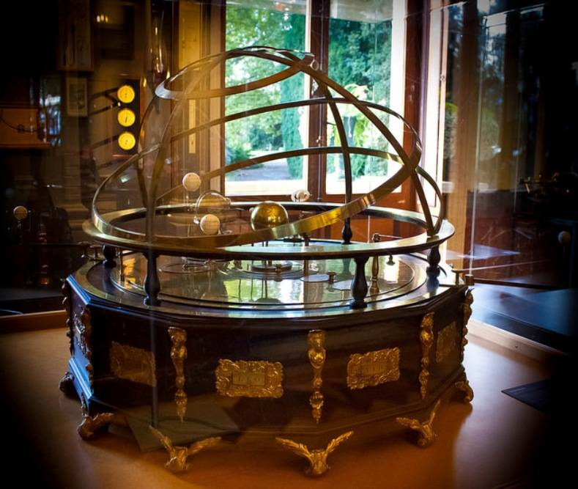
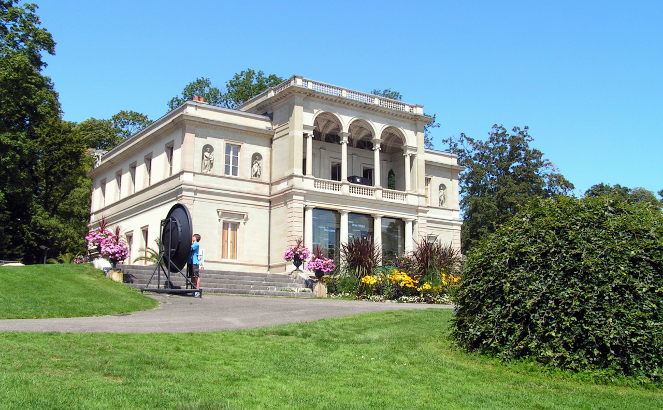

Slide 28
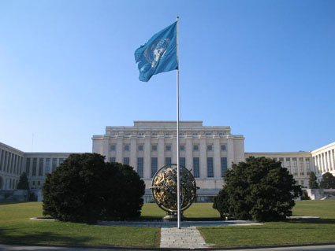
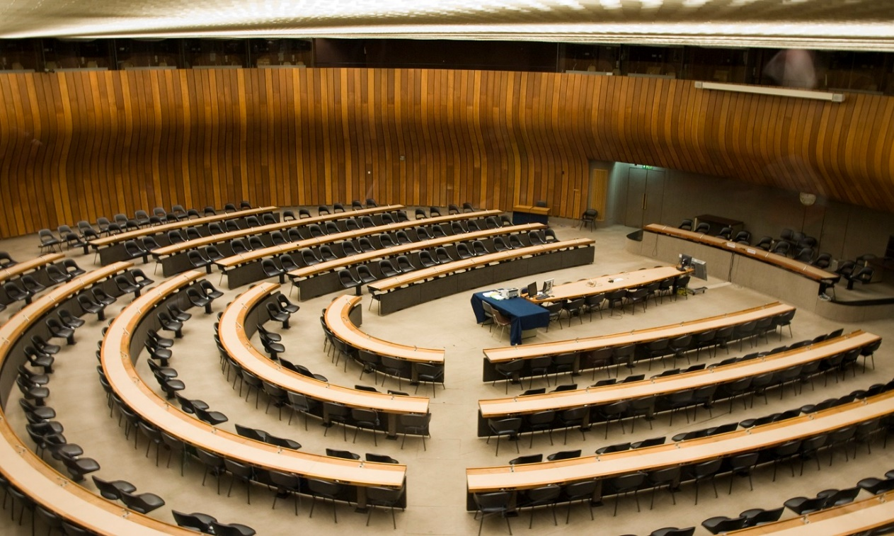
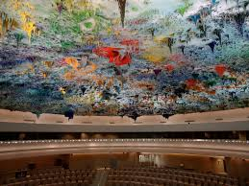

Slide 29
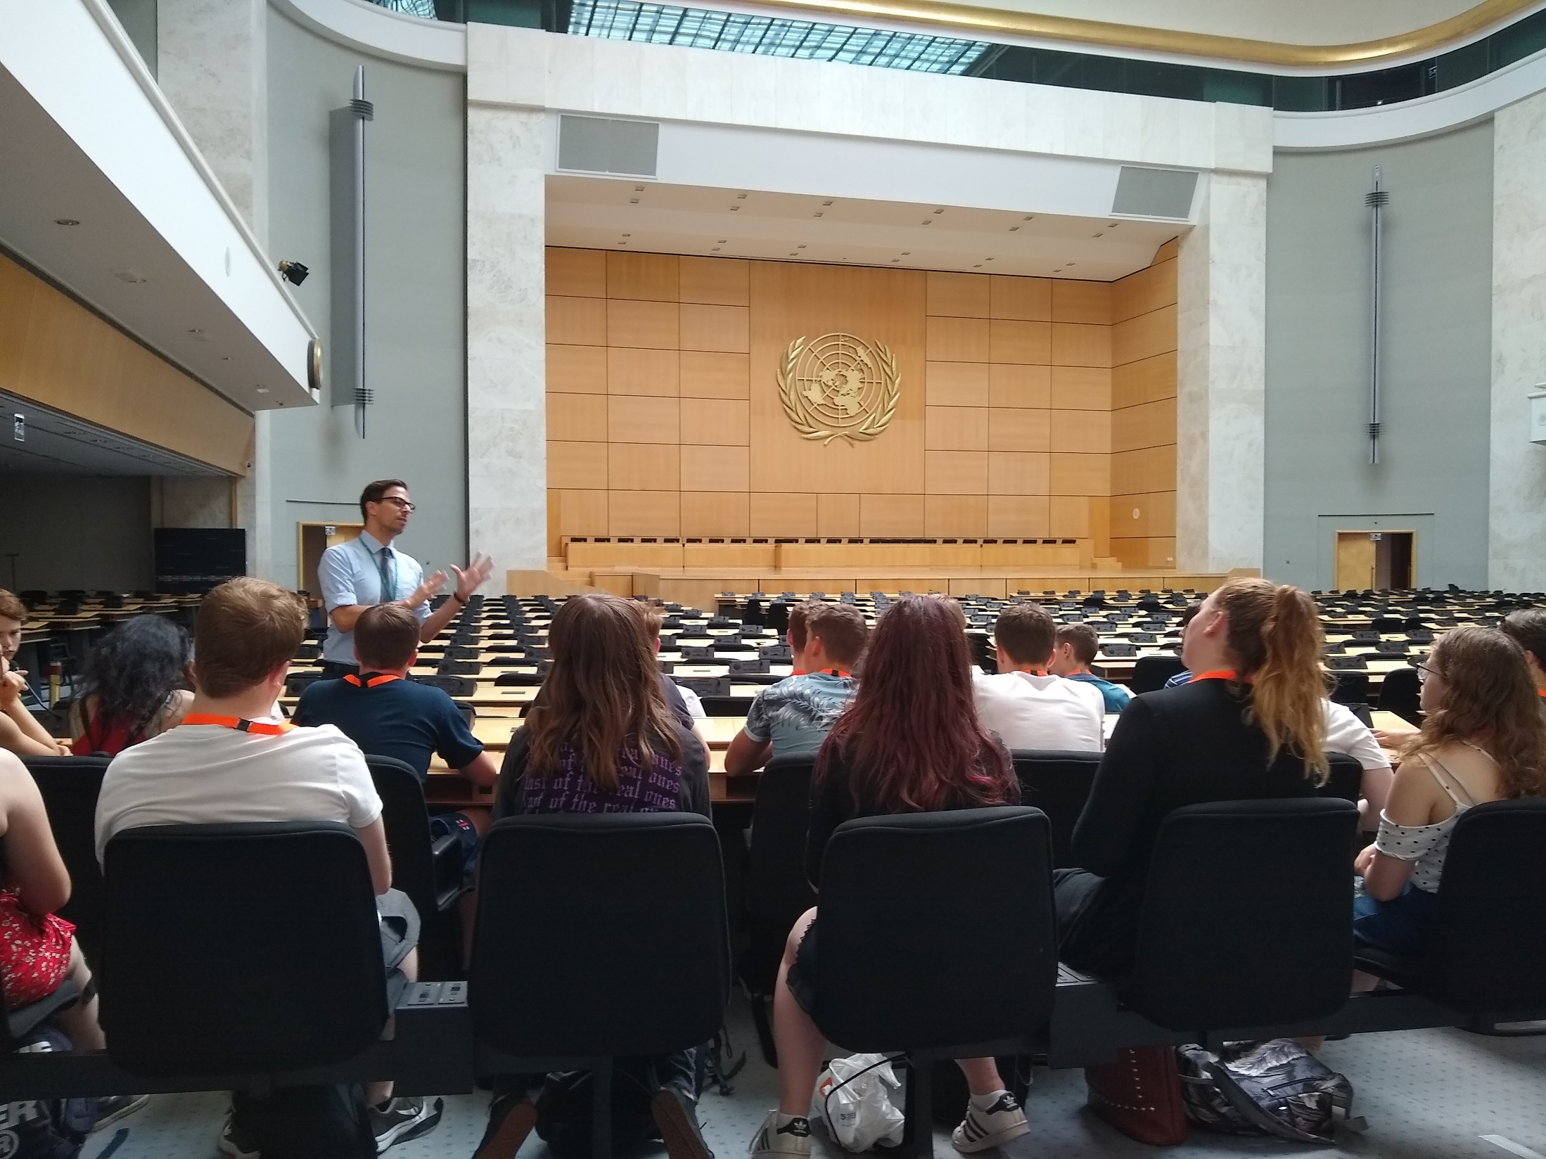

Slide 30
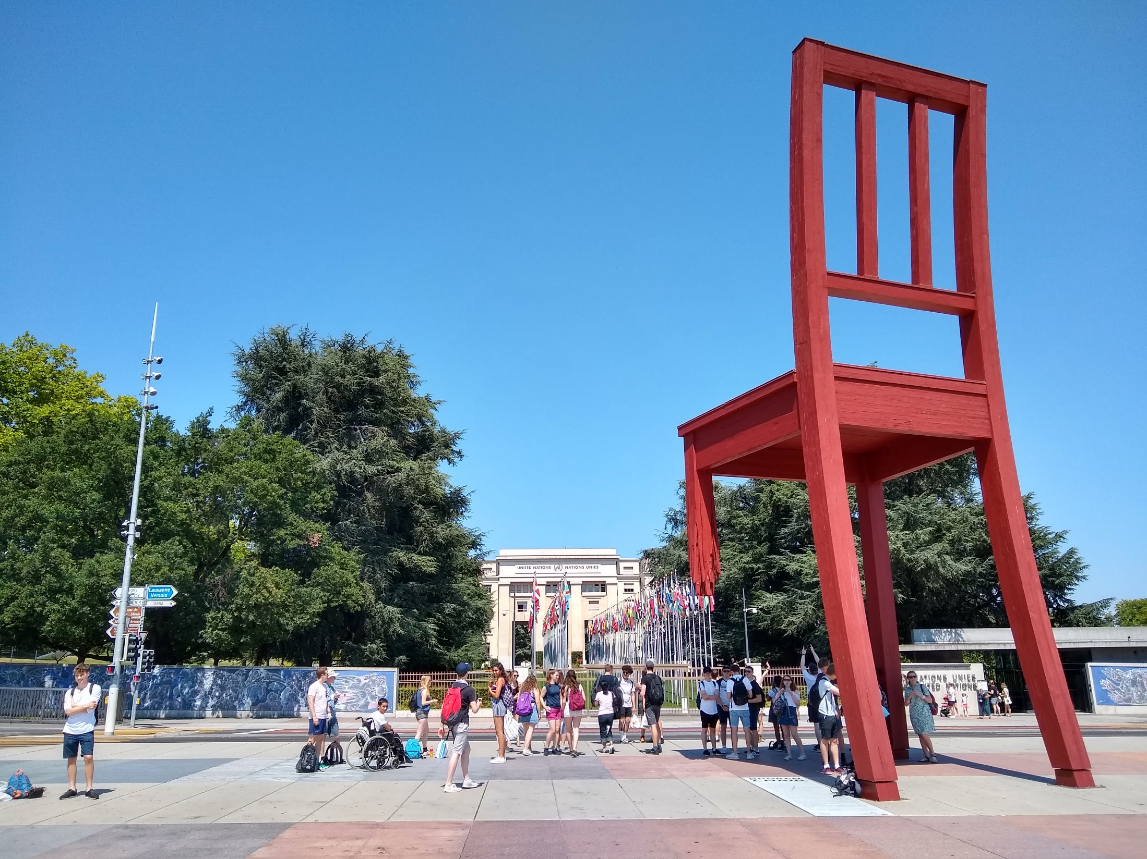

Slide 31
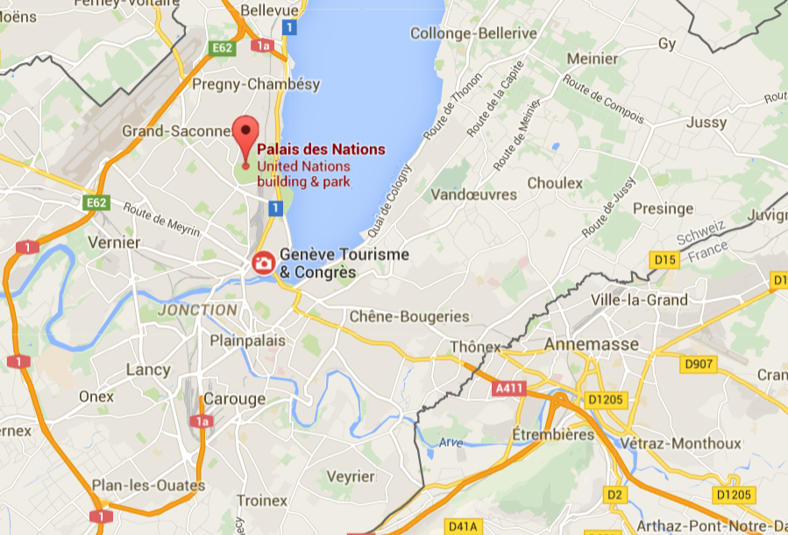

Slide 32
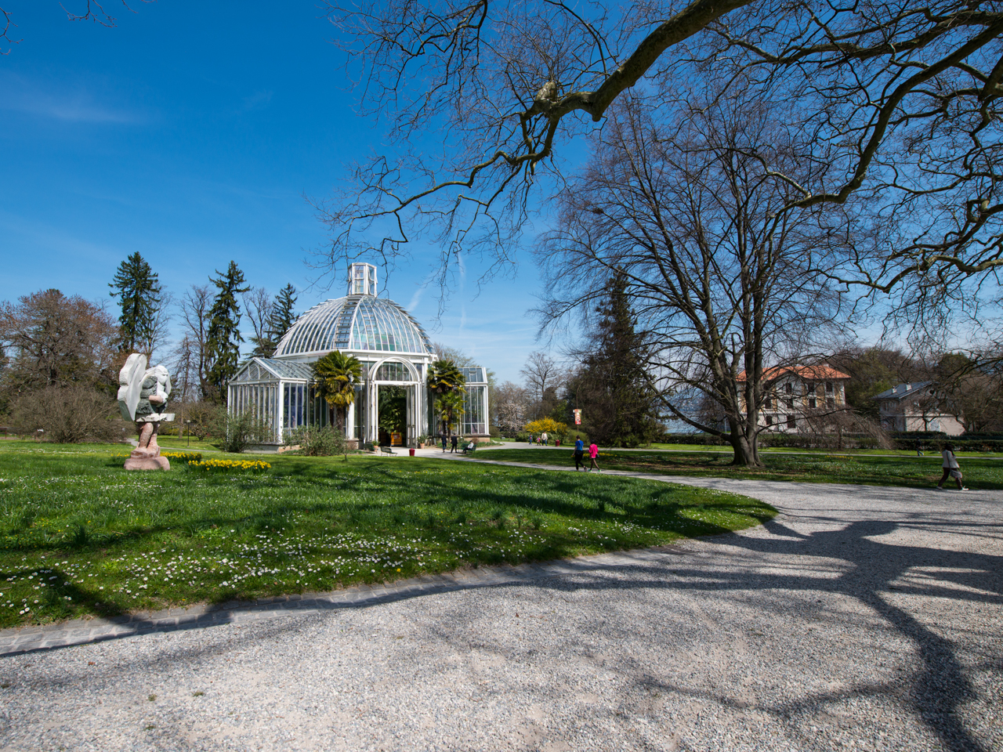

Slide 33
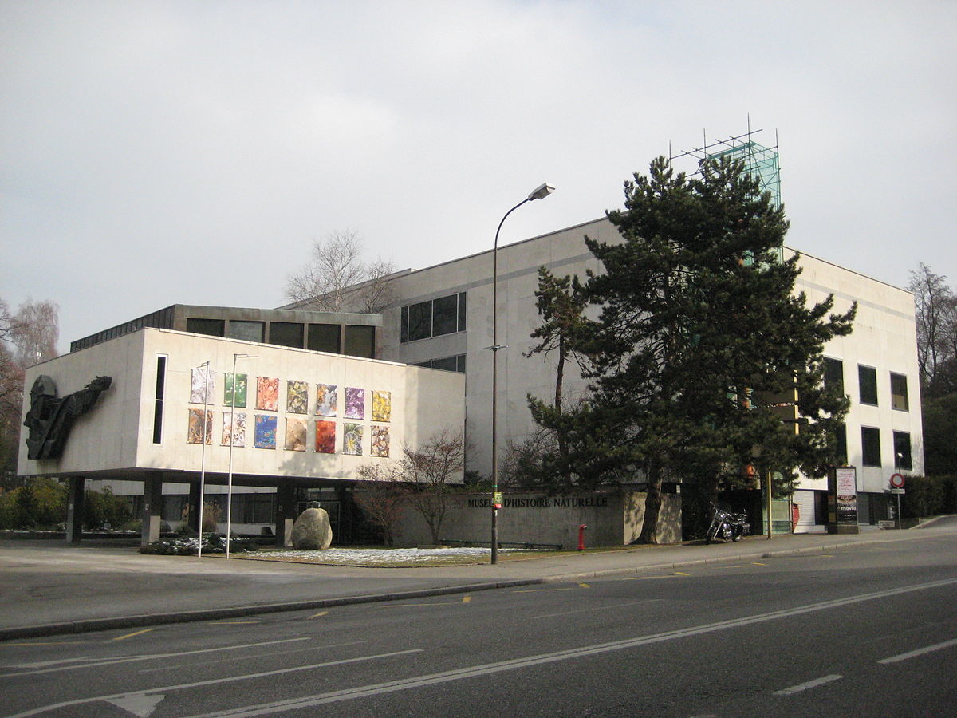

Slide 34
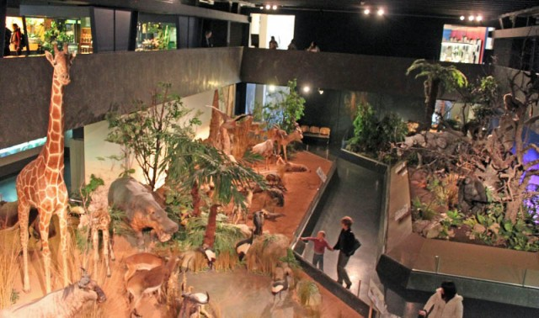
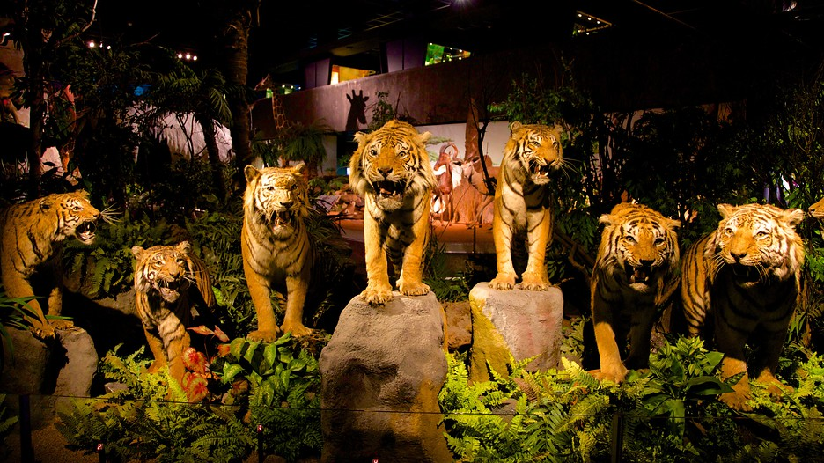

Slide 35
Medical Details
GHIC Card- Please bring it to me as soon as possible and make sure it is in date.
There will be a Microsoft Form sent out by the nurses office in advance of the trip. Please complete this as soon as you receive it letting us know about up to date medical conditions.
Please ensure medication is brought, with spares if possible.

Slide 36
Student Expectations
The expectations of the students are exactly the same as in school.
Any serious incidents such as those involving drugs, alcohol or smoking will result in that student being flown back home.

Slide 37
Spending Money
A Swiss Franc is about 91 pence.
There are a limited number of opportunities to spend any money.
Big shops and museums will accept Euros.
Many online banks now offer cards with no fees for spending abroad e.g. Monzo.

Slide 38
Contact
Please ensure that students have European enabled phone contracts if you wish to keep in contact with them.
Bear in mind cost of data etc. abroad.
Students can use their phones but should be mindful they are in Geneva to experience the culture and company!

Slide 39
Kit List
Clothes
Towels
Sun cream
Water proof
Sensible walking shoes
Students are allowed small cabin bag and a 15kg hold bag each.

Slide 40
The School Trips Insurance is with the RPA. Policy No: URN 137139
All trips are covered on this policy. The policy covers the following:
Cancellation and Other Expenses
Medical and Associated Expenses
Personal Accident
Personal Effects and Money all Property Insured except Mobile Phones and Electronic Devices

Slide 41
Any questions?

