Slide 1
Year 11 Post 16 Options and Beyond

Slide 2
Progression Routes…
Education Level

Slide 3
Typical Progression After Year 11…
Associated Sixth Form
Other Sixth Forms
College
Apprenticeships
Everyone needs a Plan B
76%
2%
19%
3%

Slide 4
Associated Sixth Form

Slide 5
Associated Sixth Form…
Overall Requirements for Entry
Plus Subject Entry Requirements

Slide 6
Associated Sixth Form…
Familiar… but different
Study 3 subjects in Year 12 and 13
Additional Offering
EPQ
Core Maths/AS Maths
GCSE Maths/English Language re-sit
4th A Level

Slide 7
Associated Sixth Form…
Product Design
Fine Art
Media Studies
Photography
Physics
Music
Travel and Tourism
Psychology
Fashion and Textiles
Science
Religious Studies
Mathematics
Drama & Theatre
Sport (double award)
English Language
Business
Ancient History
French
Economics
Geography
Food Science and Nutrition
Dance
German
Chemistry
Politics
Business
Computer Science
IT
Physical Education
English Language & Literature
Sociology
Performing Arts
English Literature
Spanish
Biology
History
Music Technology
Health and Social Care
Graphic Communication

Slide 8
College

Slide 9
College…

Slide 10
Vocational Courses…
Courses which are primarily assessed through assignments and coursework
Last up to two years and open multiple progression routes
Enable you to:
Combine work experience with academic study
Receive focused learning on their area of interest
Develop technical skills for higher study or work
Examples include:
Uniformed Public Services
Health and Social Care
Computing and Digital Technology
Business Management and Finance

Slide 11
T Levels…
2 year technical qualifications, equivalent to 3 A levels, focusing on work skills
Offered at Harrogate, York, and Leeds City Colleges ​
Digital Production, Design and Development​
Software, Cyber Security and Network Engineering​
Laboratory Science​
Construction Design, Planning and Surveying​
Health​
Management and Administration
Hair, Beauty and Aesthetics
80% college, 20% unpaid industry placement​

Slide 12
College…
Leeds City and York colleges offer A Levels
All college options have entry requirements
Level 3 – 4/5 grade 4’s
Level 2 – 4/5 grade 3-4
Level 1 – 2/3 grade 1-3
Entry Level
Open Events
Student Only Taster Days – sample courses/facilities/travel
January and February – advance booking

Slide 13
Apprenticeships

Slide 14
Apprenticeships…
Employment with training - nationally recognised qualifications
Earn and learn – typically £110-£300 per week
1,500 job roles across 170 industries
No age limit – available post-18
www.apprenticeships.org.uk

Slide 15
Apprenticeship Levels…

Slide 16
Apprenticeships…
www.findapprenticeship.service.gov.uk
Local apprenticeship providers
VQ Solutions
FW Solutions
Estio Training
Local colleges
Direct applications

Slide 17
Apprenticeship Myths…
Apprenticeships are only for manual trades
Apprenticeships have no scope for progression
Although there is a wide range of apprenticeships in construction, and IT services, which are very hands-on, there are also a vast choice of trades such as law, fashion, media and engineering
Approx. 65% of apprentices are hired permanently by their employer after their programme has finished and a 33% who remain in the same company receive a promotion in their first year
University graduates earn more than apprentices
Apprenticeships are for those who don’t perform academically
By the time a graduate has just qualified, an apprentice may have completed their End Point Assessment and will already have 1-2 years industry experience and no student loan!
They are fantastic opportunity for all looking to increase their skills through work-based learning
Apprenticeships are only for lower level employees
Whilst there are apprenticeships at lower levels, there are also a wide range of higher and degree level apprenticeships

Slide 18
Employer is Seeking…

Slide 19
Apprenticeships…

Slide 20
What Happens Next…?
Jan – March
Individual Careers Appointments
Oct – March
College Open Events & Taster Days
Feb - March
Apply to Sixth Form
&/or College
May – June
Concentrate on GCSEs
June - August
Work Experience
GCSE Results
March – July
Apply for Apprenticeships

Slide 21
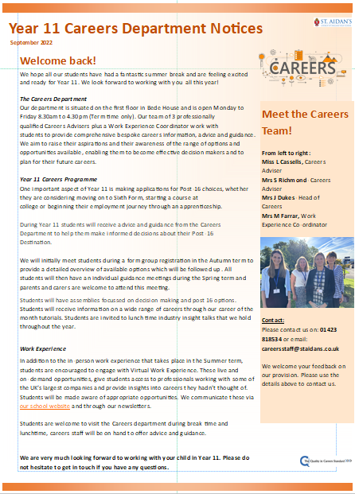
Keeping in Touch…

Slide 22
Keeping in Touch…
Open Monday-Friday 9am – 4pm
01423 818534
careersstaff@staidans.co.uk
We look forward to working with you…

